Slide 1
UNDERSTANDING THE DISTRIBUTION OF FITNESS EFFECTS (DFE) ACROSS ENVIRONMENTS
EXPLORING THE STATISTICAL PROPERTIES OF FITNESS LANDSCAPES USING THE FISHER’S GEOMETRIC MODEL
Shahnewaz Ahmed

Slide 2
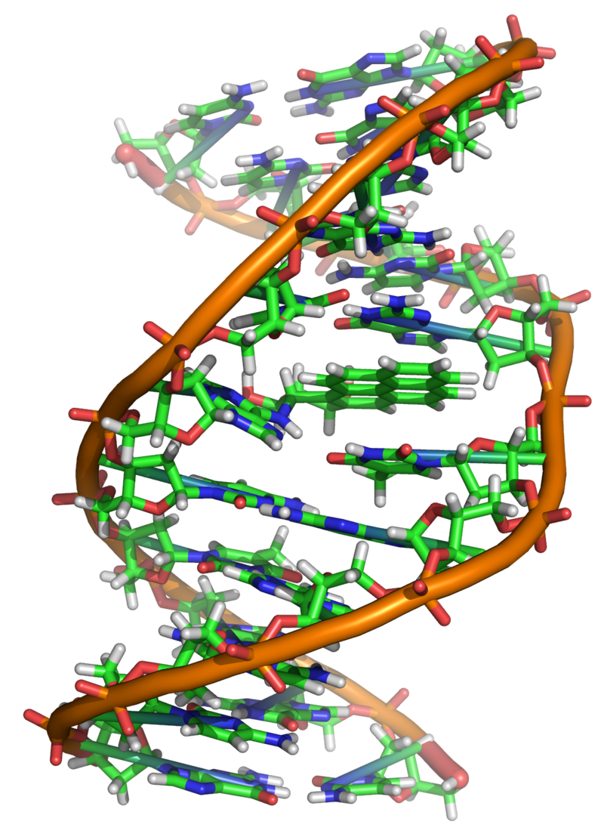
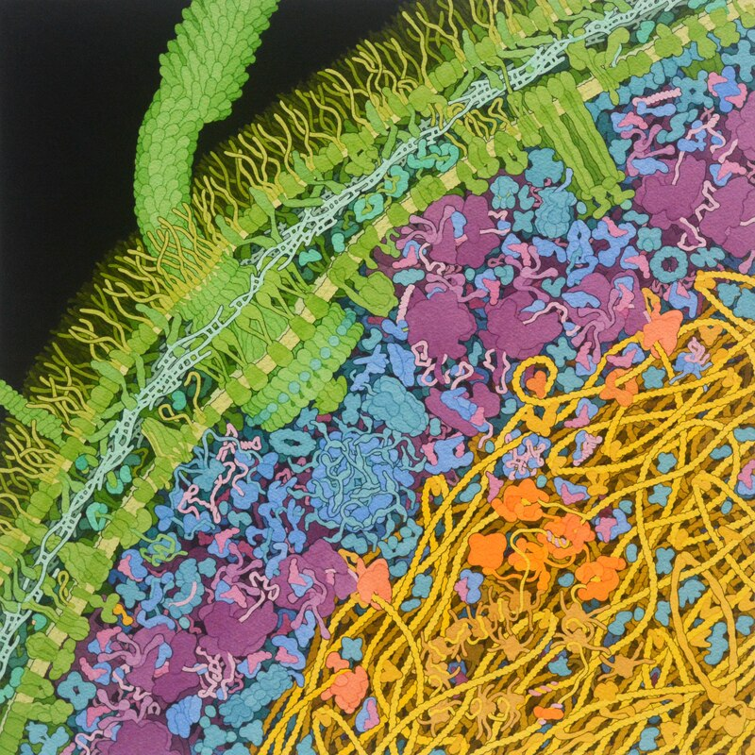

Fundamental Scales of Living Matter
Genotype (Molecular/Microscopic scale)
Fitness
(Macroscopic/Population scale)
Phenotype (Mesoscopic/Cellular scale)
Source: Wikipedia

Slide 3
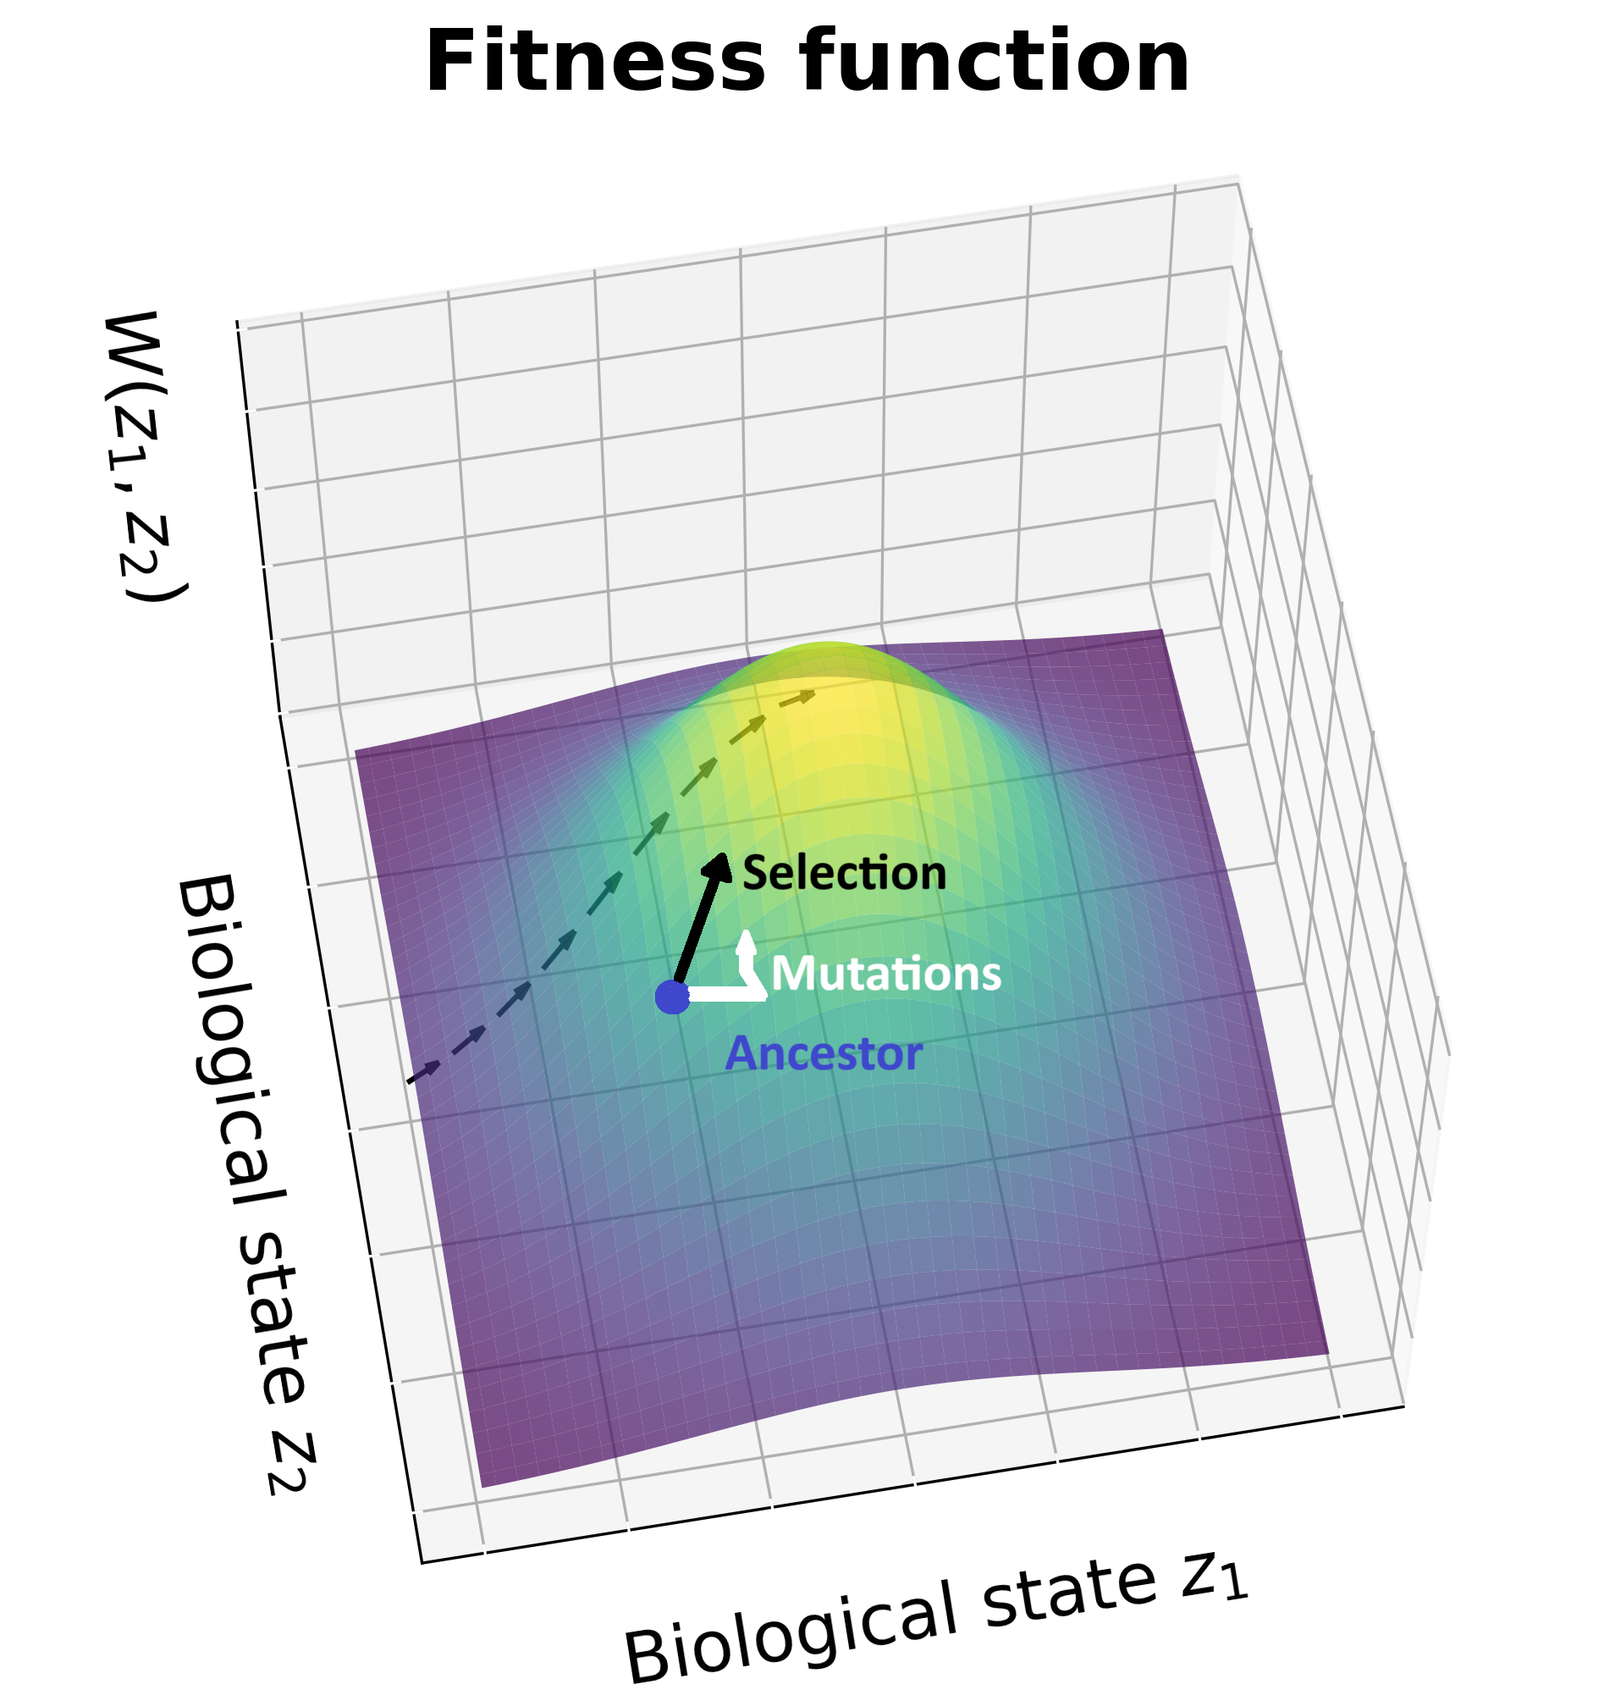
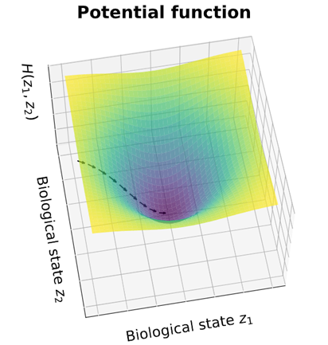
Evolutionary Analog of Statistical Mechanics
Fitness Energy
Mutations Entropic force
Finite size fluctuation Thermal fluctuation

Slide 4
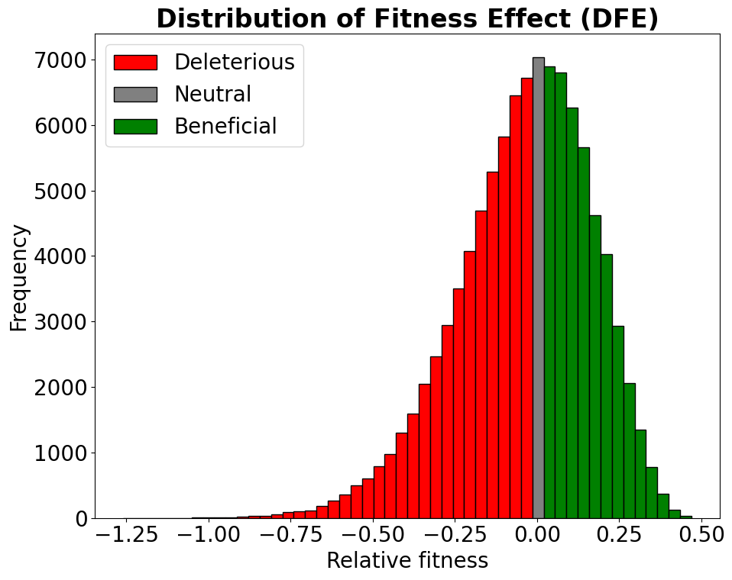

Slide 5
Importance of DFE
Understanding what kind of effect mutation have on species especially on humans
Central to questions in evolutionary biology
Quantitative genetic variation

Slide 6
Key Questions
* How does the distribution of fitness effects (DFE) change across different environments?
* Are the mean and variance of the DFE more sensitive to environmental changes than the overall shape?
* What is the correlation of fitness effects for mutations across different environments?
Notes:
Importance of Predicting Mutant Fitness:
Predicting the fitness of mutants is crucial because it lies at the heart of understanding evolutionary dynamics. Fitness determines how mutations spread or diminish in populations, influencing adaptation rates, genetic diversity, and the emergence of traits. Without accurate predictions, we cannot forecast how populations (e.g., pathogens, crops, or endangered species) will respond to environmental pressures like antibiotics, climate change, or habitat shifts.
Applications and Insights from DFE:
Evolutionary Biology: The DFE reveals the spectrum of possible mutations (beneficial, neutral, deleterious) and their probabilities, informing models of adaptation and genetic drift.
Medicine: Understanding DFEs helps predict antibiotic resistance in bacteria or cancer progression driven by somatic mutations.
Biotechnology: Optimizing microbial strains for industrial applications (e.g., biofuel production) by targeting mutations with predictable fitness outcomes.
Ecology: Forecasting how species adapt to stressors like temperature or pH changes, aiding conservation efforts.
Real-World Motivation:
The research addresses a fundamental gap: while we can write general equations for evolutionary dynamics (e.g., mutation-selection balance), we lack knowledge of the "fitness landscape"—how genotypes map to fitness in specific environments. Advances in high-throughput mutagenesis and fitness assays now provide data to tackle this, but integrating this with predictive models remains challenging. By linking DFEs to environmental variables, this work aims to bridge theory and empiricism, offering tools to anticipate evolutionary outcomes in real-world scenarios, from public health to ecosystem resilience.
Key Challenge: The DFE is environment-dependent, and environments are high-dimensional (e.g., nutrient levels, pH). Current models struggle with this complexity, necessitating new theoretical frameworks grounded in empirical data.

Slide 7
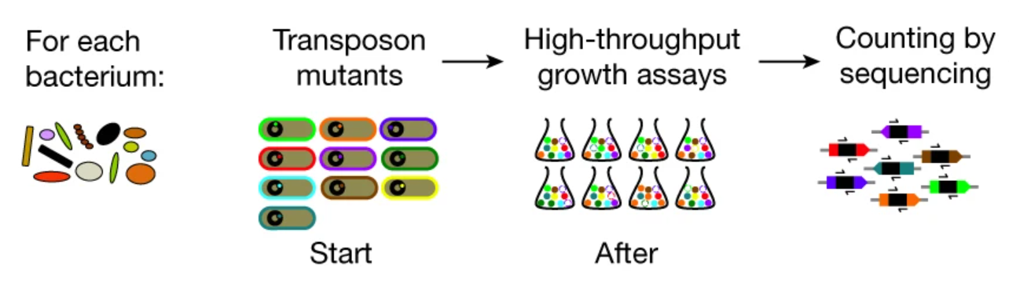
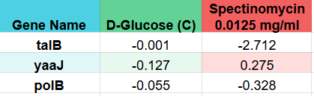
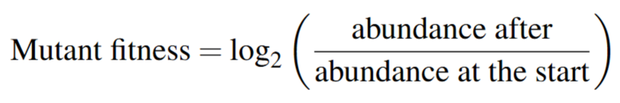
Experiment
Source: Price et. al. 2018

Slide 8
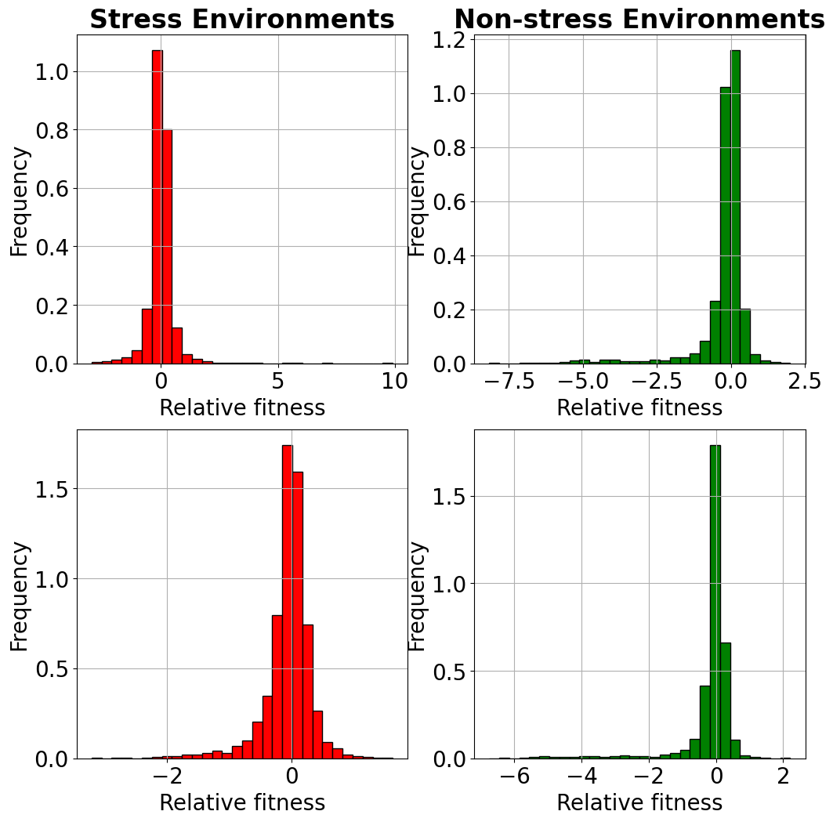
Distribution of Fitness Effect from Experimental Data

Slide 9
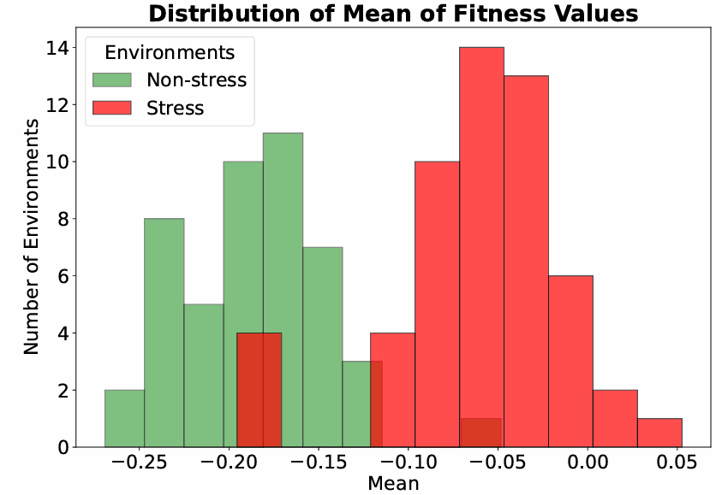

Slide 10
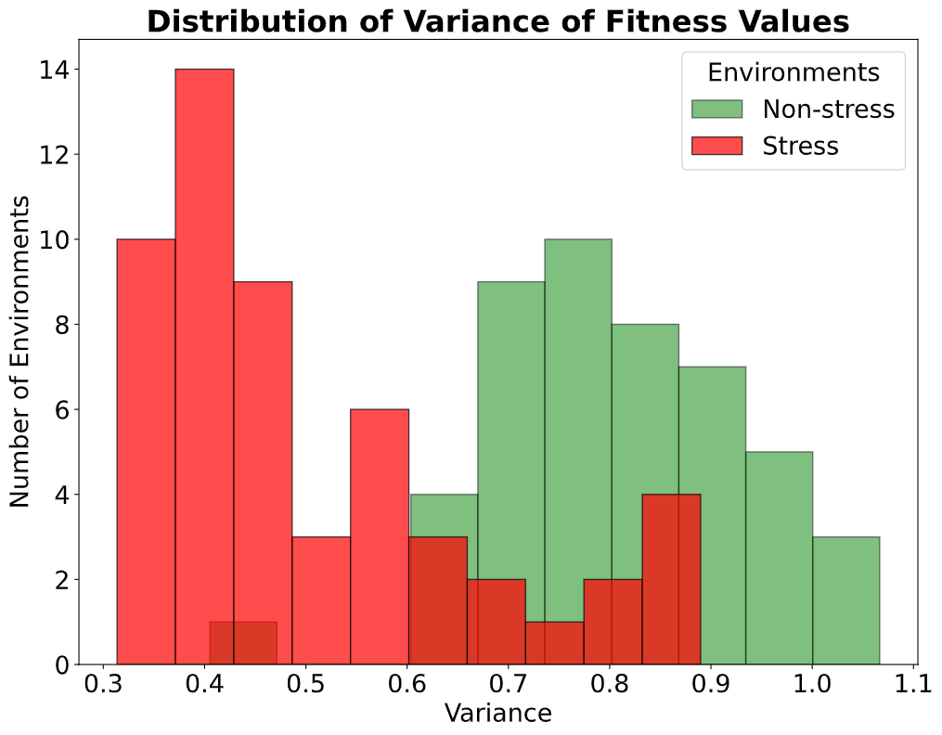
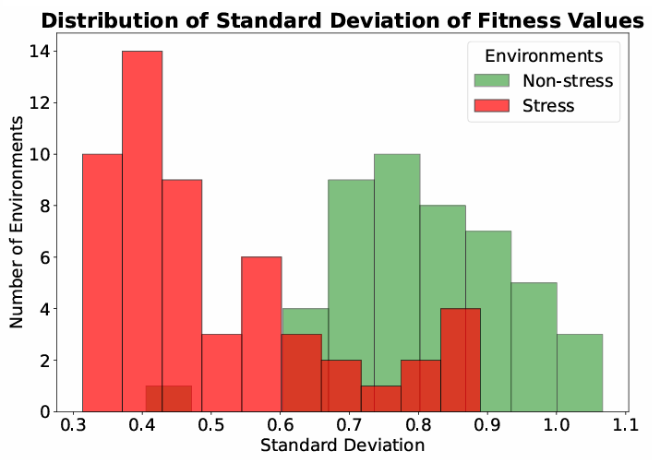

Slide 11
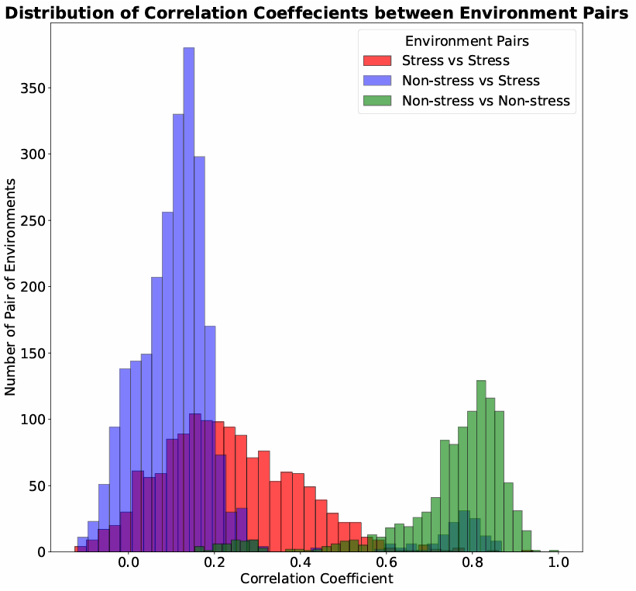

Slide 12
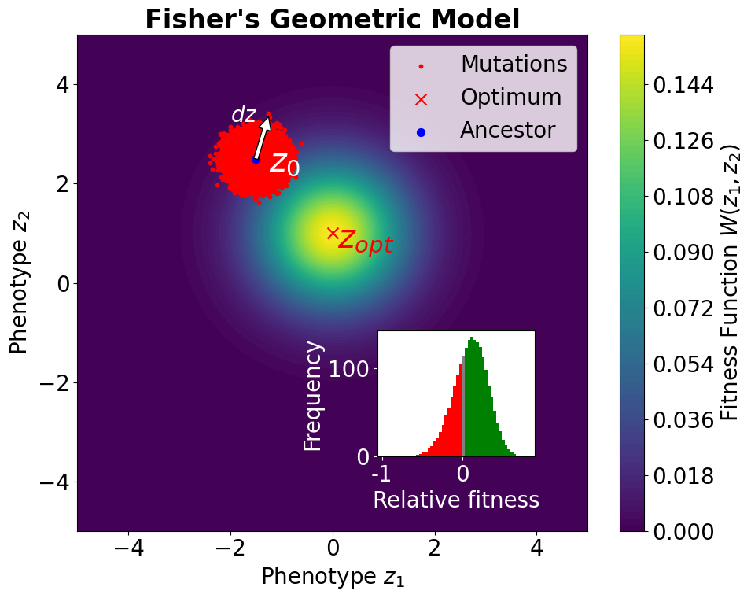
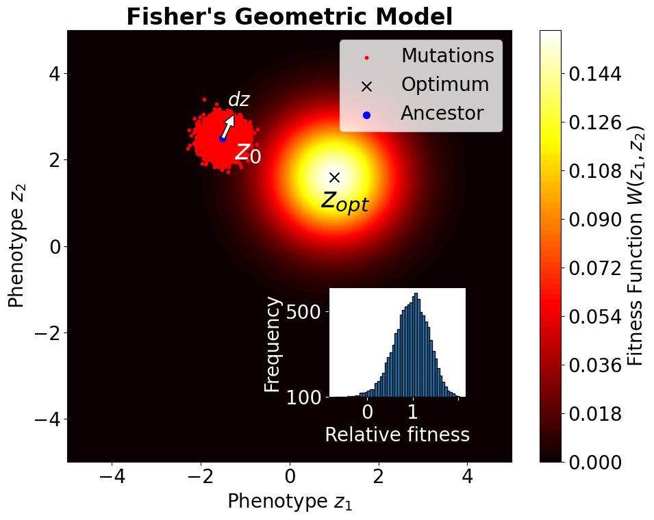
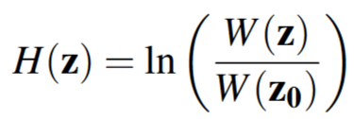
Relative
Fitness

Slide 13
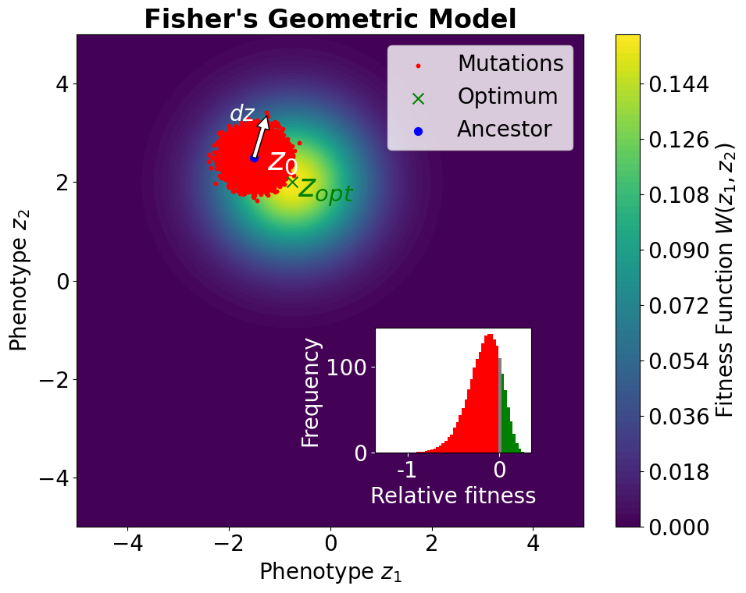
Relative
Fitness

Slide 14
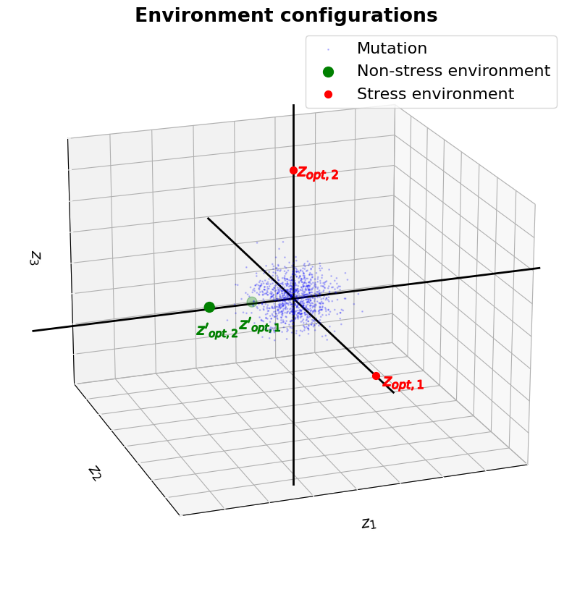
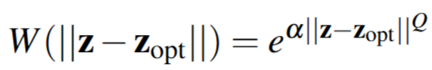
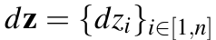
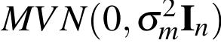
Fitness Function
Mutant Distribution

Slide 15
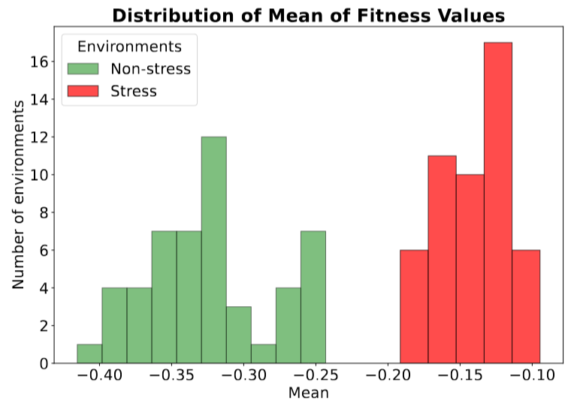
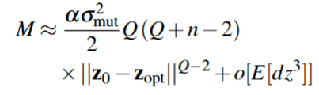
Mean of DFE

Slide 16
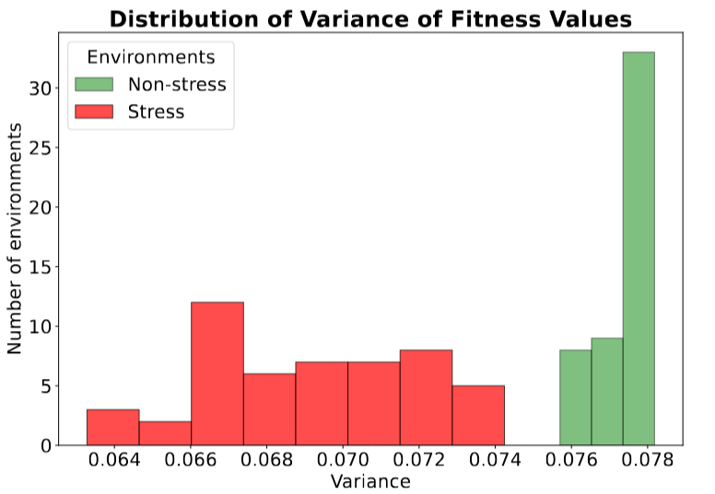
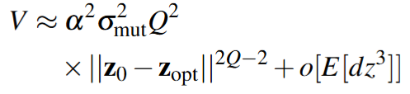
Variance of DFE

Slide 17
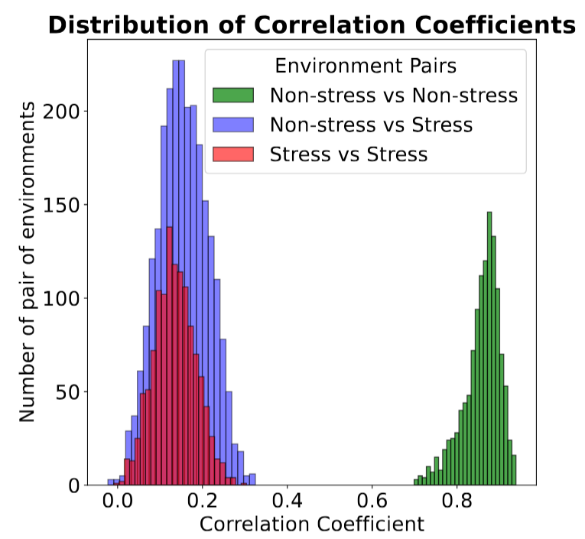
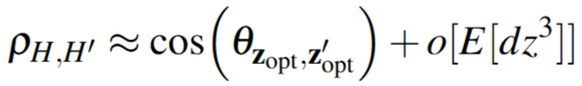
Correlation Coefficient

Slide 18
Conclusion
Mechanistic Models: Link DFEs to molecular mechanisms (e.g., protein stability, metabolic fluxes) to move beyond phenomenological descriptions.
Environment Dimensionality: Develop scalable methods to handle high-dimensional environmental spaces (e.g., multi-nutrient gradients, biotic interactions).
Epistasis and Dynamics: Explore how DFEs change as populations evolve (i.e., epistasis) and incorporate temporal environmental fluctuations.
Cross-Species Frameworks: Test whether DFE patterns generalize across bacteria, eukaryotes, or viruses, revealing universal evolutionary constraints.

Slide 19
Thank You

Slide 20
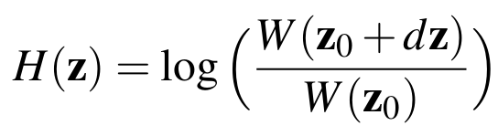
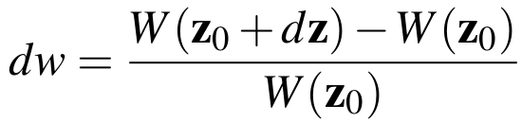
Key Assumptions
7. Fitness potential:
Relative fitness:

Slide 21
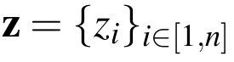
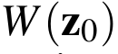
Key Assumptions
Phenotype Space:
Genotype to Phenotype Relationship:
Phenotypic Fitness Landscape:
Monotonicity of Fitness Function
Environmental Change
Stress and Non-stress Environment

Slide 22
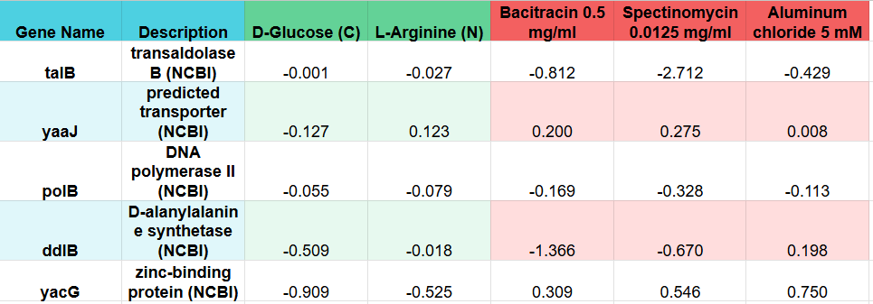
Dataset
Source: Price et. al. 2018

Slide 23
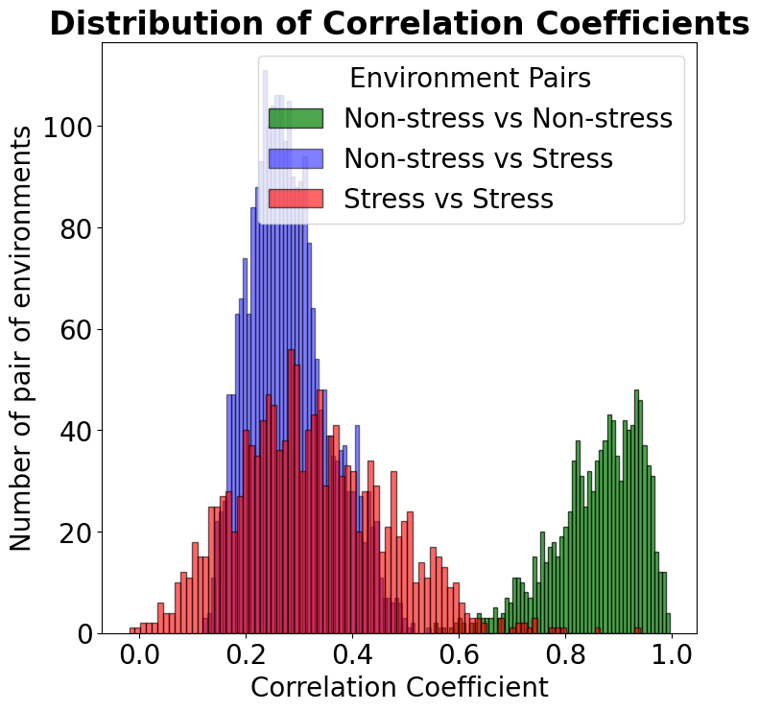

Slide 24
